Slide 1

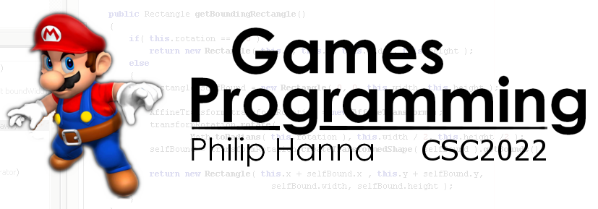
Coding Advice for Performance
Practical advise on how to write fast code for managed language

Slide 2

The Importance of Optimisation

Slide 3

Optimisation is the process of developing your program so that it uses the minimal amount of some resource. Resources can include CPU time, memory, hard-disk space, network traffic, etc. Optimisation approaches can focus on:
Design – ensuring the design employs optimal algorithms, minimises redundancy, etc.
Implementation – ensuring the code optimally maps onto CPU instructions, avoids inefficient data usage, etc.
This section focuses on code optimisation.

Slide 4



: Start and Stop
Design Optimisation - Go! Good performance comes about by getting the architectural design right. Given the cost of refactoring, carefully consider performance in your design.
Code Optimisation – Stop! Code optimisation can be ‘expensive’ in terms of time and complexity. It is generally recommended not to heavily optimise code until there is a clear need to do so.
Quote attributed to C.A.R. Hoare: "We should forget about small efficiencies, say about 97% of the time: premature optimisation is the root of all evil”

Slide 5

: The Process
Whenever the UPS or FPS targets cannot be obtained, profile the game to find the areas consuming most CPU/GPU time.
Based on the profiling and the design, decide which areas can be optimised and how they will be optimised.
Implement optimisations, re-profile, and repeat until desired targets obtained.
If targets cannot be reached, then the wider game design and/or game feature set must be reconsidered.

Slide 6

: JIT – A Helping Hand
Managed languages, such as Java and C#, tend to use JIT (just-in-time) compilers when compiling from the intermediate language (IL) into native code at runtime.
A good JIT compiler will help optimise code, often by:
Constant folding / copy propagation
Method in-lining
Extraction of loop invariants
Loop unrolling (for small loops)
Aside: Due to the diversity and fragmentation of Android devices, it is difficult to make any assumptions (not all devices may have a JIT).

Slide 7

: The Cost of Optimisation
Optimising code for performance can be risky and normally has an associated cost.
Examples of risks and costs include:
Breaking code that works
Limiting the reusability and/or extensibility of the code by introducing additional constraints
Making the code harder to understand and maintain.
IMPORTANT: The above refers to coding design to explicitly increase the execution speed. It is not an excuse to write code that is needlessly inefficient.

Slide 8

Improved efficiency means improved battery life. Efficiency matters.

Slide 9

Creating Objects

Slide 10

Whenever an object is created (in Java, C#, etc.) there is a construction cost:
Memory is allocated for all instance variables (including from super-classes)
All instances variables are initialised to starting values.
The constructor (including those of any super-classes) are executed.
Given this cost, it is good practice to avoid needless and excessive object creation.

Slide 11

: Hints and Tips
✗
Use primitive data types rather than wrapper classes, e.g. use an int instead of an Integer.
Use lazy object creation / avoid creating conditional objects unless conditions are matched.
Use string literals instead of String objects where possible (as string literals are interned and reused)
1 | Integer val = 4+5;
2 | Int val = 4+5;
✓
1 | String message = “...” + name;
2 | if (printMessage)
3 | outputMessage(message);
✗
1 | if (printMessage) {
2 | outputMessage(“...” + name);
3 | }
✓
✓
1 | String str1 = ”Hello”; // Literal
2 | String str1 = new String(”Hello”); // Object
✗

Slide 12

: Garbage Collection
Garbage collection (GC) is a form of automatic memory management. The GC automatically deletes objects and reclaims memory from ‘discarded’ objects.
GC makes manual memory de-allocation unnecessary, freeing the programmer from having to release objects (which can be an error prone process).
However, garbage collection can have performance implications that are difficult to manage.

Slide 13

: Garbage Collection
For game developers the key questions to ask are:
How long does a GC take (in ms)
When and how often does a GC occur
An acceptable balance between ‘how long’ and ‘how often’ is desirable, e.g. a GC once every several second might incur a high cost that introduces a perceivable skip in the frame rate. Lots of GCs / second will likely introduce a high (and unnecessary overhead).

Slide 14

: General Advice
Avoid creating new objects and reuse existing objects where possible:
Use an object pool to provide a collection to reusable objects.
Recycle and reuse objects instead of creating a new one.
Use lazy initialisation to defer object creation until it is needed.

Slide 15

Calling Methods

Slide 16
Consider the shown code. The length() method will be called for each iteration (with stack push/pop costs for method parameters and returns). For a large loop it can be a heavy additional expense.
Where the result of the method call is invariant over the duration of the loop, it is good practice to extract the method call, and store the result before the loop, e.g.
1 | long getAccLength(long stringObj) {
2 | long len = 0;
3 | for {int i = 0; i<stringObj.length(); i++)
4 | len+=(i+1);
5 | return len;
6 | }
✗
1 | long getAccLength(long stringObj) {
2 | long len = 0;
3 | int size = stringObj.length();
4 | for {int i = 0; i<size; i++)
5 | len+=(i+1);
6 | return len;
7 | }
✓
Aside: Ideally just calculate it as n(n+1)/2, where n is the length.

Slide 17

✗
Avoid excessive re-calculation by computing the expression once and binding the result to a variable which is reused.
Making chunky calls…
A chunky call is a function call that performs several related tasks (e.g. initialising fields).
A chatty call only does one thing (with several chatty calls needed to get things done). Favour chunky calls for processes that run numerous times per second.
1 | if (enemies.elementAt(i).isAlive()) ...
2 | if (enemies.elementAt(i).isBoss()) ...
3
4 | Enemy enemy = enemies.elementAt(i);
5 | if (enemy.isAlive()) ...
6 | if (enemy.isBoss()) ...
✓

Slide 18

Boxing
and
Unboxing

Slide 19
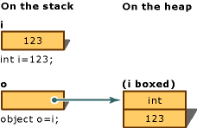
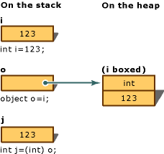
Boxing is the creation of a reference wrapper for a value type (e.g. storing an int within an Integer). Unboxing is the conversion of the reference wrapper to the value type.
Boxing
Unboxing
1 | int i = 123;
2 | obj o = (obj)i;
1 | obj o = o(123);
2 | int i = (int)o;

Slide 20

Boxing and unboxing are computationally expensive processes as a new object must be created every time a value type is boxed. This can be more than an order of magnitude slower than a simple assignment.
The casting process when unboxing also takes longer than a simple assignment. Additionally, boxing/unboxing places a greater load on the GC.

Slide 21
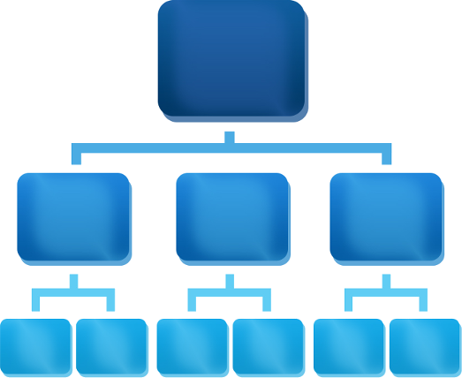
Data
Structures

Slide 22

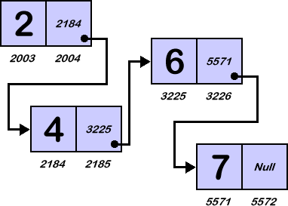
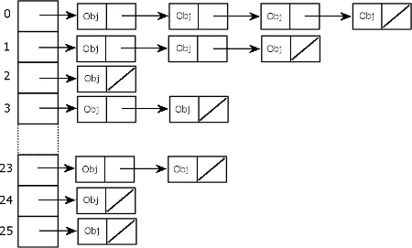
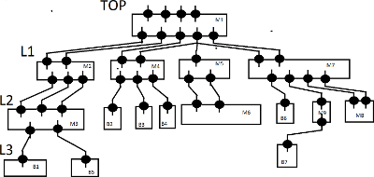
Use an array instead of an ArrayList if the size can be fixed.
Use an ArrayList if data will be frequently accessed and not simply iterated over. Use a LinkedList if lots of values need to be inserted or deleted from the middle of the list.
Use a HashMap or TreeMap to hold object pairing (key, value). Use a HashMap if the objects do not need to be accessed in a sorted order. Use a TreeMap if the objects need to be iterated over in a sorted order.

Slide 23

Key takeaways:
By using a few simple guidelines it is possible to write code that will not be inefficient.
On the other hand, making code optimally efficient typically requires a lot of time and effort and generally lessens maintainability/extensibility.

